Slide 1
CS2S562
Secure Software Development
String Security

Slide 2
Recap: Risk = S x L x R
Severity - How serious are the consequences
  1 = low (denial-of-service attack, abnormal termination)
  2 = medium (data integrity violation, unintentional information disclosure)
  3 = high (run arbitrary code, privilege escalation)
Likelihood - How likely is it an exploitable vulnerability
  1 = unlikely
  2 = probable
  3 = likely
Remediation Cost - How expensive is it to fix
  3 = high (manual detection and correction)
  2 = medium (automatic detection and manual correction)
  1 = low (automatic detection and correction)

Slide 3
Looking Back
In previous week
  Unsigned Integer wrapping
  Signed integer overflow
  Use of uintn_t and intn_t for consistency
  Labs look at preventing wrapping/overflow

Slide 4
Looking Ahead…
In Coursework:
  You will be asked to demonstrate the use of the String class and char[ ] in a secure way.
  Keep lab and self study notes safe (in you head, on paper, on file)
  You will also be asked to demonstrate the secure use of integers from last week.

Slide 5

String Vulnerabilities
Lang. | Description | Severity | Likelihood | Remediation Cost | Risk
C++ | Storage for string must have enough space for data and null terminator | 3 | 3 | 2 | 18
C++ | Do not attempt to create a std::string from a null pointer | 3 | 3 | 2 | 18
C++ | Use valid references, pointers, and iterators to reference elements of a basic_string | 3 | 2 | 3 | 18
C | Do not pass a non-null-terminated character sequence to a library function that expects a string | 3 | 2 | 2 | 12
C | Do not confuse narrow and wide character strings and functions | 3 | 3 | 1 | 9
C++ | Range check element access | 3 | 1 | 2 | 6
C | Do not attempt to modify string literals | 1 | 3 | 1 | 3
Table data source CERT.org
Possible Values: 1, 2, 3, 4 6, 8, 9 12, 18, 27
Note: ‘C’ in above table means ‘C and C++’
Notes:
To a certain extent, integers covered last week are not a great problem, at least we know they are always going to be whole numbers in a particular range.
Strings pose a different problem as there is literally no limit to what someone could type in. Therefore we should expect a greater range of potential problems!
We will focus on the ‘high risk’ IE anything above 10 in this lecture.

Slide 6
Space for Data & null Terminator
Extract from the ‘Common Weakness Enumerator’ (CWE) Top 25 list http://cwe.mitre.org/top25/index.html
Rank | Score | ID | Name
[1] | 93.8 | CWE-89 | Improper Neutralization of Special Elements used in an SQL Command ('SQL Injection')
[2] | 83.3 | CWE-78 | Improper Neutralization of Special Elements used in an OS Command ('OS Command Injection')
[3] | 79.0 | CWE-120 | Buffer Copy without Checking Size of Input ('Classic Buffer Overflow')
[4] | 77.7 | CWE-79 | Improper Neutralization of Input During Web Page Generation ('Cross-site Scripting')
[5] | 76.9 | CWE-306 | Missing Authentication for Critical Function
[6] | 76.8 | CWE-862 | Missing Authorization
[7] | 75.0 | CWE-798 | Use of Hard-coded Credentials
[8] | 75.0 | CWE-311 | Missing Encryption of Sensitive Data
[9] | 74.0 | CWE-434 | Unrestricted Upload of File with Dangerous Type
[10] | 73.8 | CWE-807 | Reliance on Untrusted Inputs in a Security Decision
Notes:
Looking at a different chart, we can see the scale of the problem we are about to explore, this list is not just C++ but the largest weaknesses in software. As you can see, this weakness is third on the list, so a very common problem that is overlooked.

Slide 7

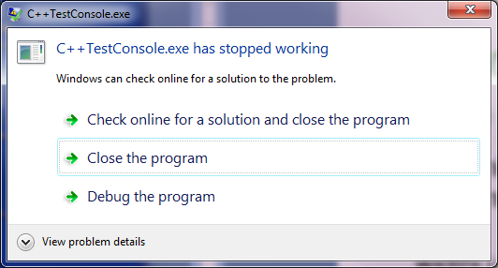

Space for Data & null Terminator
Spot the problem:
#include <iostream>
void aFunction() {
char buf[12];
std::cin >> buf;
}
In ‘Debug’ mode
When running .exe
In ‘Release’ mode
Notes:
If we just run this code as is, then we don’t have a problem, as long as our input is kept below 12 letters, however if we go over this, we can run into some of these errors.

Slide 8
A running program (a process)
max
stack
heap
data
code
0

Slide 9
(Excursion: Buffer Overflow Attack)
Dynamic memory allocation is on the Heap
  This is reasonably safe. Any overflow will most likely cause a crash as pointers are not allowed to access heap memory that does not belong to it.
Static memory is allocated on the Stack
  Stack memory belongs to the program that is running and there is no check.
char *ptr = (char*) malloc(10);
ptr[10] = 'c'; // ----> crash
char buff[10] ;
strcpy(buff, "This String is too long"); // > no crash
Memory
  The buffer overflow quietly corrupts the neighbouring memory. If corrupted memory is being used by the program it can cause unexpected results.
  More in a few weeks.
Stack
Heap
Static / Global
Code
Notes:
The stack contains runtime data. This is allocated when the program is running. The stack is allocated at the top of memory and as it grows, it expands into the lower memory addresses. When we store data, we allocate a space on the stack and store the data from the lowest address to the highest address, so any data that is larger than the expected amount will go over into neighboring space. This could cause something as simple as a crash, but in worst case, if we know what we are doing, we can actually overwrite data to execute malicious code.

Slide 10

Space for Data & null Terminator
Back to the problem:
#include <iostream>
void aFunction() {
char buf[12];
std::cin >> buf;
}
std::ios_base::width() to the rescue ?
#include <iostream>
void aFunction() {
char bufOne[12];
char bufTwo[12];
std::cin.width(12);
std::cin >> bufOne;
std::cin >> bufTwo;
}
limits to 12 but may truncate string
width() only works for the next cin and then resets to ‘width(0)’.
Notes:
So one way of stopping the character overflow is to simply specify a width when allowing input. This is a good start, however your issue here is that you would have to specify the width every time you get input, which can just be annoying! There has to be a simpler way, so we see this on the next slide..s

Slide 11

Space for Data & null Terminator
Solution:
  Use <string> wherever possible
  But that is not without problems either: what about null pointers?
#include <iostream>
#include <string>
void aFunction() {
std::string stringOne;
std::cin >> stringOne;
}
Notes:
So generally, the data type String is set up to solve the problem of buffer overflows, and really unless you have a specific need for it, you should avoid using char arrays!
However Strings are not without their errors, as we see in the vulnerabilities page next..

Slide 12
Quick Pit Stop
C has a lot of old problems
  Developed in 1970
  C was developed with
  “principles”
  Point 6 contained;
Trust the programmer.
Don’t prevent the programmer from doing what needs to be done.
Keep the language small and simple.

Slide 13
String Vulnerabilities
Lang. | Description | Severity | Likelihood | Remediation Cost | Risk
C++ | Storage for string must have enough space for data and null terminator | 3 | 3 | 2 | 18
C++ | Do not attempt to create a std::string from a null pointer | 3 | 3 | 2 | 18
C++ | Use valid references, pointers, and iterators to reference elements of a basic_string | 3 | 2 | 3 | 18
C | Do not pass a non-null-terminated character sequence to a library function that expects a string | 3 | 2 | 2 | 12
C | Do not confuse narrow and wide character strings and functions | 3 | 3 | 1 | 9
C++ | Range check element access | 3 | 1 | 2 | 6
C | Do not attempt to modify string literals | 1 | 3 | 1 | 3
Table data source CERT.org
Possible Values: 1, 2, 3, 4 6, 8, 9 12, 18, 27
Note: ‘C’ in above table means ‘C and C++’
Notes:
So if we have a string with a null pointer, we should not try to create another string based on that.

Slide 14
String from null pointer example
Spot the problem:
  getenv() returns a so called environment string. In this example this is the path to the temporary storage folder.
#include <cstdlib>
#include <string>
void aFunction() {
std::string tmp( std::getenv("TMP") );
if (!tmp.empty()) {
// ...
}
}
  getenv() returns a null pointer on failure. As a result the string tmp is initialised to null. The call to tmp.empty() will fail (empty means ‘no characters’ but not ‘no pointer’)
Notes:
Here, we are calling a function called getenv, which returns an environment string, for example, getenv(“TMP”) might return the path to the temporary files on the current running machine. However, if there is no path, or we supply an unknown value to getenv, then a null string is returned, which is then passed to tmp in the code above.
Our following line of code tmp.empty() will fall on a null object, so will trigger a failure in the code.

Slide 15
String from null pointer
Solution:
  Check before assigning:
#include <cstdlib>
#include <string>
void aFunction() {
const char *tmpPtr= std::getenv("TMP");
if( tmpPtr == NULL ) {
// error message here
{
}
Notes:
To avoid the problem in the slide before, we can simply check the pointer to the string before we create the actual string. (pointers are not strings so that’s OK if it’s a null)
As long as the pointer is not null, then we are good to go ahead and create the string. If it is, we avoid creating it.

Slide 16
String Vulnerabilities
Lang. | Description | Severity | Likelihood | Remediation Cost | Risk
C++ | Storage for string must have enough space for data and null terminator | 3 | 3 | 2 | 18
C++ | Do not attempt to create a std::string from a null pointer | 3 | 3 | 2 | 18
C++ | Use valid references, pointers, and iterators to reference elements of a basic_string | 3 | 2 | 3 | 18
C | Do not pass a non-null-terminated character sequence to a library function that expects a string | 3 | 2 | 2 | 12
C | Do not confuse narrow and wide character strings and functions | 3 | 3 | 1 | 9
C++ | Range check element access | 3 | 1 | 2 | 6
C | Do not attempt to modify string literals | 1 | 3 | 1 | 3
Table data source CERT.org
Possible Values: 1, 2, 3, 4 6, 8, 9 12, 18, 27
Note: ‘C’ in above table means ‘C and C++’
Notes:
The basics of string creation are covered in the previous two vulnerabilities, now the next weakness focuses on when we are using a string, and the pointers or references we use to refer to a string.

Slide 17

Invalid References to String
Spot the problem:
  This code will fail because the iterator loc is invalidated after the first call to insert();
void replaceSemicolonWithSpace(const std::string &input) {
std::string someText;
std::string::iterator loc = someText.begin();
auto b = input.begin();
auto e = input.end();
for (auto i = b; i != e; ++i)
{
if (*i == ';') someText.insert(loc, ' ');
else someText.insert(loc, *i);
++loc;
}
std::cout << "Output: "<<someText;
}
Notes:
Essentially, the iterator is based on a string, and once that string has been modified, then the iterator is no longer guaranteed to work properly! We may end up removing characters from the string and if the iterator is not informed, it still thinks that the string is the original length, hence the overflow error.

Slide 18

Invalid References to String
Solution:
  The value of loc is updated as a result of insert();
replaceSemicolonWithSpace("Hello;World;how;are;you");
void replaceSemicolonWithSpace(const std::string &input) {
std::string someText;
std::string::iterator loc = someText.begin();
auto b = input.begin();
auto e = input.end();
for (auto i = b; i != e; ++i)
{
if (*i == ';') loc = someText.insert(loc, ' ');
else loc = someText.insert(loc, *i);
++loc;
}
std::cout << "Output: "<<someText;
}
Notes:
Here we re-generate the iterator when we change the string, so we can continue to loop knowing that the iterator is not going to go past the end.

Slide 19
Avoid Code Obfuscation
Which code is more secure?
  Note: no difference in speed or performance between the two
void replaceSemicolonWithSpace(const std::string &input) {
std::string someText;
std::string::iterator loc = someText.begin();
auto b = input.begin();
auto e = input.end();
for (auto i = b; i != e; ++i)
{
if (*i == ';') loc = someText.insert(loc, ' ');
else loc = someText.insert(loc, *i);
++loc;
}
std::cout << "Output: "<<someText;
}
void replaceSemicolonWithSpace(const std::string &input) {
std::string someText;
std::string::iterator loc = someText.begin();
for (auto i = input.begin(), e=input.end(); i != e; ++i, ++loc)
{
loc = someText.insert(loc, *i != ‘;’ ? *i:’ ‘);
}
std::cout << "Output: "<<someText;
}
Notes:
The key point here is that confusing code is more likely to contain mistakes, because it’s harder to read. What benefit do we really get from writing fancy code when the speed of execution is the same speed regardless? That’s an important point to remember!

Slide 20
String Vulnerabilities
Lang. | Description | Severity | Likelihood | Remediation Cost | Risk
C++ | Storage for string must have enough space for data and null terminator | 3 | 3 | 2 | 18
C++ | Do not attempt to create a std::string from a null pointer | 3 | 3 | 2 | 18
C++ | Use valid references, pointers, and iterators to reference elements of a basic_string | 3 | 2 | 3 | 18
C | Do not pass a non-null-terminated character sequence to a library function that expects a string | 3 | 2 | 2 | 12
C | Do not confuse narrow and wide character strings and functions | 3 | 3 | 1 | 9
C++ | Range check element access | 3 | 1 | 2 | 6
C | Do not attempt to modify string literals | 1 | 3 | 1 | 3
Table data source CERT.org
Possible Values: 1, 2, 3, 4 6, 8, 9 12, 18, 27
Note: ‘C’ in above table means ‘C and C++’
Notes:
This ties back to the first problem, having a character sequence is fine, but don’t then convert it to a string via a function call if it doesn’t have a termination sequence at the end!

Slide 21
Passing non-null Terminated Character Sequences
The problem:
  Many C / C++ string library functions expect a properly null terminated string
  If string not null terminated then memory outside the bounds of string object may be accessed
  Example: printf()
  Visual Studio picks this up (but not all other compilers):
#include <stdio.h>
void func(void) {
char c_str[3] = "abc";
printf("%s\n", c_str);
}
3 chars → OK,
but:
‘\0’ → no space
Notes:
We’ve gone back against the earlier advice and not used <String>
Because there is no space for the terminating character this is an issue.

Slide 22
Passing non-null Terminated Character Sequences
Solution:
  Do not specify the bound of the character array:
  Compiler will allocate sufficient storage for abc and \0
#include <stdio.h>
void func(void) {
char c_str[ ] = "abc";
printf("%s\n", c_str);
}

Slide 23
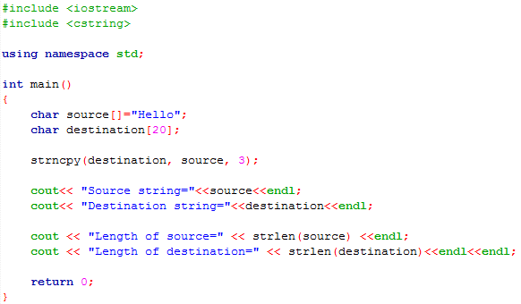
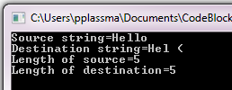
Passing non-null Terminated Character Sequences
Another problem:
  strncpy( ) copies n characters and returns an un-terminated string (i.e. no ‘\0’ terminator)
  A call to strlen( ) fails:
The problematic line
CodeBlocks and GCC compiler
Notes:
Here the 3rd argument is specifying only to copy the first three characters, and it’s a. shortcoming of the strncpy function that it doesn’t pass over the termination character.

Slide 24
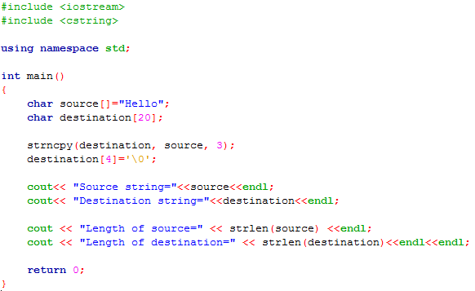

Passing non-null Terminated Character Sequences
Solutions:
  Add ‘0\’ manually:
CodeBlocks and GCC compiler
Notes:
This is a tedious workaround that has been produced here, and not something we want to work with going forward.

Slide 25
Passing non-null Terminated Character Sequences
Solutions:
  Use the new strxxxxx_s( ) functions (strcpy_s(), strcat_s(), strnlen_s(), ...)
  All _s functions feature:
    Buffer overflow protection
    Guaranteed null termination
    No string truncation possible
  But:
  Not part of C99
  Introduced with C11 (ISO/IEC 9899:2011, Annex K → optional)
  Making its way into libraries. Slooooowly....
  Available in Visual Studio (MS’ own version – a bit sketchy)
  Not yet in GCC
  Not as fast

Slide 26
String Vulnerabilities
Lang. | Description | Severity | Likelihood | Remediation Cost | Risk
C++ | Storage for string must have enough space for data and null terminator | 3 | 3 | 2 | 18
C++ | Do not attempt to create a std::string from a null pointer | 3 | 3 | 2 | 18
C++ | Use valid references, pointers, and iterators to reference elements of a basic_string | 3 | 2 | 3 | 18
C | Do not pass a non-null-terminated character sequence to a library function that expects a string | 3 | 2 | 2 | 12
C | Do not confuse narrow and wide character strings and functions | 3 | 3 | 1 | 9
C++ | Range check element access | 3 | 1 | 2 | 6
C | Do not attempt to modify string literals | 1 | 3 | 1 | 3
Self Study
(aka ‘homework’)
Table data source CERT.org
Possible Values: 1, 2, 3, 4 6, 8, 9 12, 18, 27
Note: ‘C’ in above table means ‘C and C++’

Slide 27
Summary
String vulnerabilities:
  Buffer overflow 3rd most frequent vulnerability in software generally
  Use string class wherever possible, not char[ ]
  Use the safe str…_s() methods
  If using char[ ] :
    use i < xxx.length_s() for safe upper boundary, not <=
  If using string class:
    should be null terminated (even if used with str…_s() methods)
    check if pointer to string is != NULL before use

Slide 28
End of Lecture

